Slide 1
Salesforce && UiPath
Integration

Slide 2
Salesforce
Salesforce is a customer relationship management solution that brings companies and customers together. It's one integrated CRM platform that gives all your departments — including marketing, sales, commerce, and service — a single, shared view of every customer.

Slide 3
About the Salesforce Activities Pack
The UiPath.Salesforce.Activities pack enables you to automate Salesforce processes.
It can connect to a Salesforce Org via the Salesforce Application Scope and, alongside the rest of the activities, enable you to perform actions such as file manipulation, record manipulation, report execution, and SOQL commands execution.
Once established, the connection to the Salesforce Org can be stored into a IConnectionService object and easily reused in all subsequent child Scope activities.

Slide 4
Salesforce Application Scope
Username(String)
Password(Secure String)
Security Token(Secure String)
Consumer Key(String)
Consumer Secret(Secure String)

Slide 5
Prerequisites
A Salesforce account as well as a Salesforce Connected App are both required to use the Salesforce activities. These can be acquired from your Salesforce Administrator.
Alternatively, RPA Developers can use a Salesforce Developer account for automating processes in Salesforce.

Slide 6

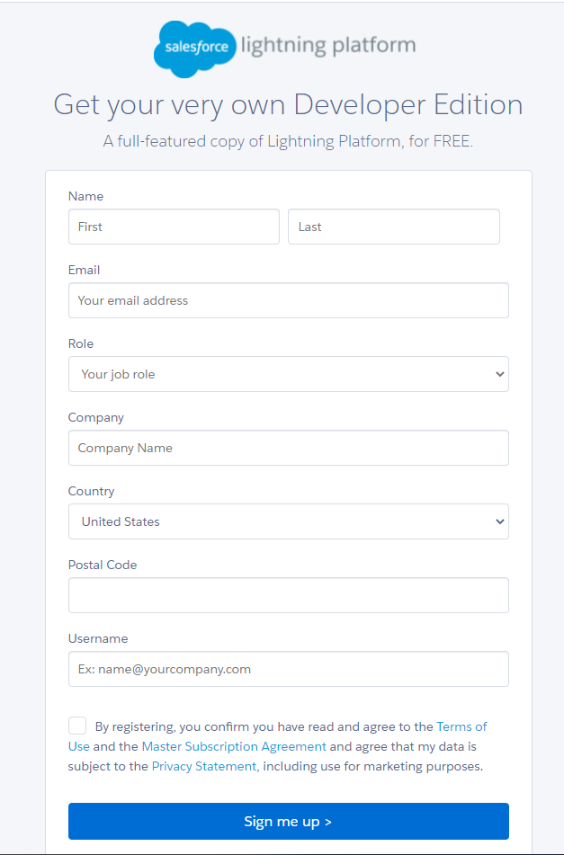
Steps to create Developer account
Open https://developer.salesforce.com/
Click on sign-up
Fill up the form

Slide 7
Consumer Key And Consumer Secret
Open https://www.salesforce.com/
Login
Click on setup
In a Quick Find search for App Manager.
Click on New Connected App
Enter Connected App Name e.g., as UiPath API
Enter API Name e.g., as Test API
Check Enable OAuth Settings
Enter Call-back URL as https://localhost:8080
Select OAuth Scopes as Full Access
Click on save

Slide 8
Security Token
Click on profile.
Click on settings.
Click on Reset My Security Token.
Click on Reset Security Token.
Automatic email will generate and send to your registered email id.

Slide 9
Salesforce Object Query Language (SOQL)
Salesforce Object Query Language (SOQL) to is to search your organization’s Salesforce data for specific information. SOQL is like the SELECT statement in the widely used Structured Query Language (SQL) but is designed specifically for Salesforce data.

Slide 10
SOQL uses the SELECT statement combined with filtering statements to return sets of data, which can optionally be ordered: SELECT one or more fields FROM an object WHERE filter statements and, optionally, results are ordered For example, the following SOQL query returns the value of the Id and Name field for all Account records if the value of Name is Sandy: SELECT Id, Name FROM Account WHERE Name = 'Sandy'
SOQL doesn’t support all advanced features of the SQL SELECT command. For example, you can’t use SOQL to perform arbitrary join operations, use wildcards in field lists, or use calculation expressions.

Slide 11
Workbench https://workbench.developerforce.com/
Workbench is free to use but is not an official salesforce.com product. Workbench has not been officially tested or documented. salesforce.com support is not available for Workbench. Support requests for Workbench should be directed to Stackoverflow at https://salesforce.stackexchange.com/questions/tagged/workbench. Source code for Workbench can be found at https://github.com/forceworkbench/forceworkbench under separate and different license terms.

Slide 12
Execute SOQL UiPath.Salesforce.Activities.ExecuteSoql
Executes a Salesforce Object Query Language (SOQL) command in Salesforce and returns the query results in a DataTable. This activity only functions inside a Salesforce Application Scope activity.
Output
Result - The result of running the SOQL command in Salesforce, stored in a DataTable variable. This field supports only DataTable variables.
SalesforceStatus - The status that is returned from Salesforce once the action is completed, stored in a SalesforceStatus variable. This field supports only SalesforceStatus variables.

Slide 13
Thank you !!
Please reach out to automationsqaudindia@gmail.com
For any Questions and Quieres..

